Slide 1
Visual and tactile based shared control for remote palpation
Jingwen Zhao
Supervisor: Fumiya Iida

Slide 2
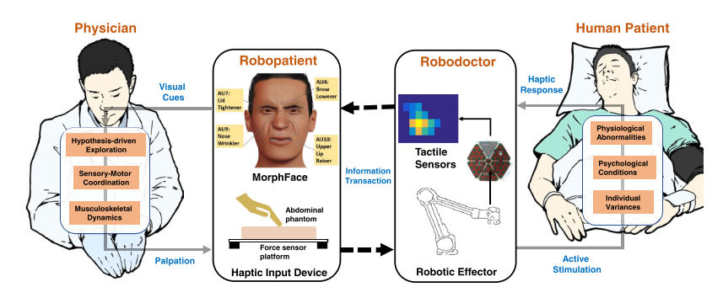
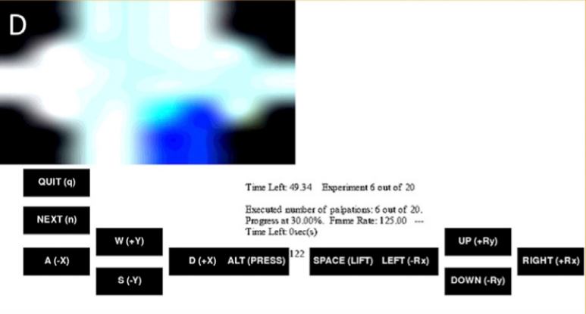
Palpation & Remote Palpation
GUI

Slide 3
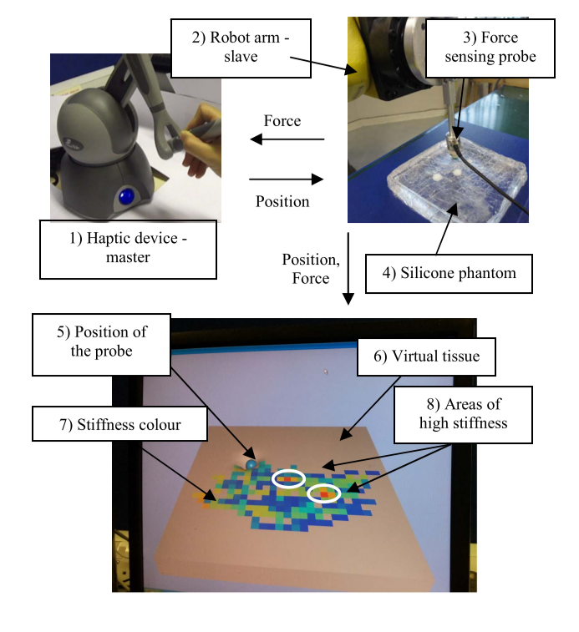
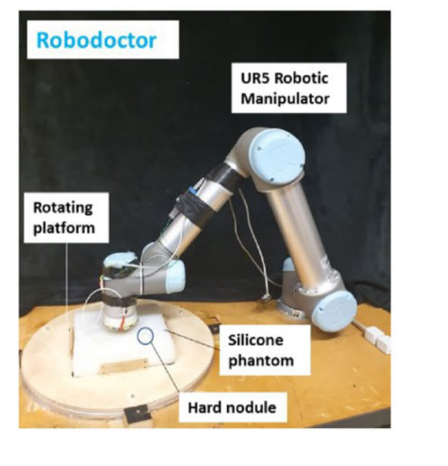
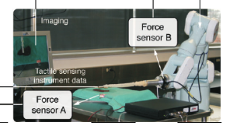
Remote palpation: current work
Notes:
Our setup: more freedom, able to perform complex palpation task
Current solution: either clumsily control full 6 DOF, or restraint the movement/setup in a certain way
Problem: how to enable user/doctors to perform dextrous palpation with our 6 DOF robotic arm
(pic1: Evaluating Manual Palpation Trajectory Patterns in Tele-Manipulation for Soft Tissue Examination)
(pic2: Robot-assisted tactile sensing for minimally invasive tumor localization)
(pic3: Face mediated human–robot interaction for remote medical examination, will need to take a good one myself)

Slide 4
Solution: shared control
Shared control
Let the robot perform what the doctor WANT to perform
Shared control teleoperation has been widely used in many industries
Hazardous waste handling, autonomous driving, prosthetic limb
…
HOWEVER, not much application is seen in the healthcare and will be the key to unlock the full potential of our remote palpation system
Notes:
[1] A visual-based shared control architecture for remote telemanipulation
[2] Programming by Demonstration for Shared Control With an Application in Teleoperation
[3] Analysis of human machine cooperation when driving with different degrees of haptic shared control
[4] A review of intent detection, arbitration, and communication aspects of shared control for physical human–robot interaction
[5] On the shared control of an EMG-controlled prosthetic hand: analysis of user–prosthesis interaction

Slide 5
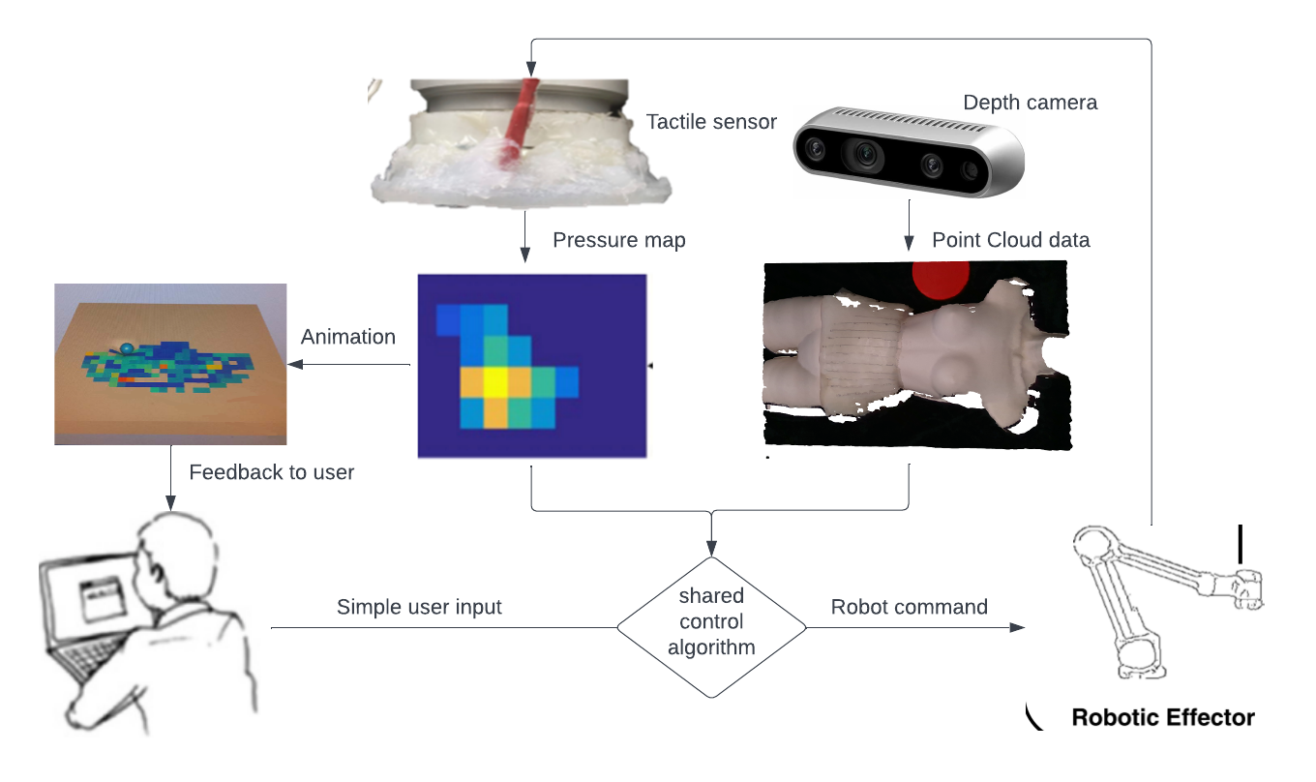
Proposed system
Notes:
Vision guided shared control
The user control only planar and normal movement, the robot handles rotation
While travelling to the desired palpation spot, the robot aims to maintain hovering above the phantom surface parallel to the surface and at constant distance
The distance control can be overridden by the user to perform palpation

Slide 6
Shared control: Vision
Step 1: phantom surface geometry reconstruction with depth camera
Capture RGBD data using depth camera at start of experiment
Segment patient and reference object
Calibrate desk orientation
Down sample and estimate normal direction (x, y) -> (z, θ, Φ)
Step 2: Convert reconstructed geometry to robot command
Interpolate to find (x, y, z, rx, ry, rz) map
“+x” -> “x+dx, y, z+∆z, rx+ ∆rx, ry+ ∆ry, rz+ ∆rz”

Slide 7
Shared control: tactile
Reinforcement learning to adjust the end effector orientation:
expose the clearest local feature
Maintain constant total force
Receive user control override

Slide 8
Experiment setup
Pic needed
Pic needed
Master side:
Controller
Screen with animated patient and pressure feedback overlay
Slave side:
Depth camera
Universal robotic arm with tactile sensor
Phantom patient

Slide 9
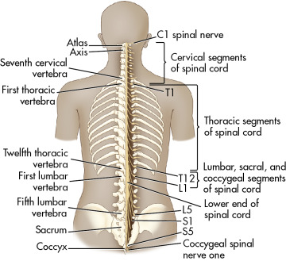
Experiment task
Simple task: find nodule, trace edge
Complex task: Lumbar spine palpation
Find lowest rib
Go along rib to the centre to find top of lumbar spine
Count the blobs of bones to locate specific lumbar vertebra
https://radiologykey.com/neonatal-and-infant-spine/

Slide 10
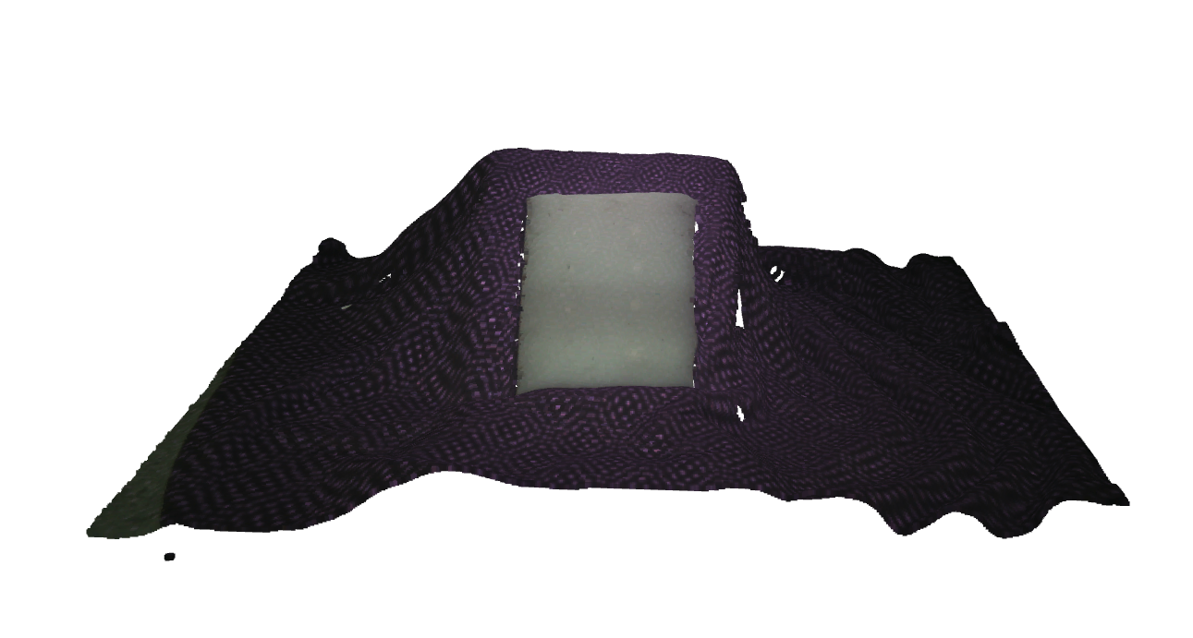
Current progress
Warm up task: reconstruction with flat phantom
Video

Slide 11
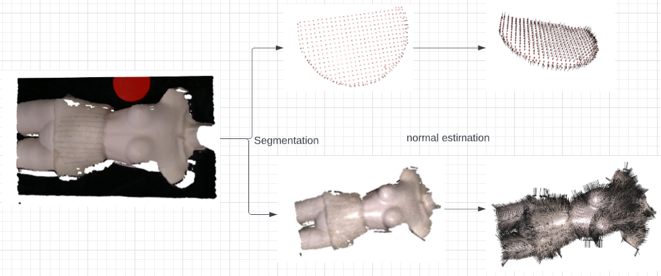
Current Progress
Reconstruction with abdominal phantom on mannequin

Slide 12
Next step
Something about Next step

Slide 13
Thank you
Q&A

Slide 14

What is the shared control algorithm going to be
Flow chart vs hardware
Reference
Slide 4,7 too much words
robot command
user command
point cloud map at TCP
pressure map feature -> orientation
shear on skin -> lift

Slide 15

Shared control: Vision
Step 1: Surface geometry reconstruction
Capture -> segmentation -> calibration -> downsample
Extract normal map (x, y) -> (z, θ, Φ)
Step 2: Control conversion
Integrate $x_{user}$ and $f_{map}(TCP)$
“+x” -> “x+dx, y, z+∆z, rx+ ∆rx, ry+ ∆ry, rz+ ∆rz”

Slide 16
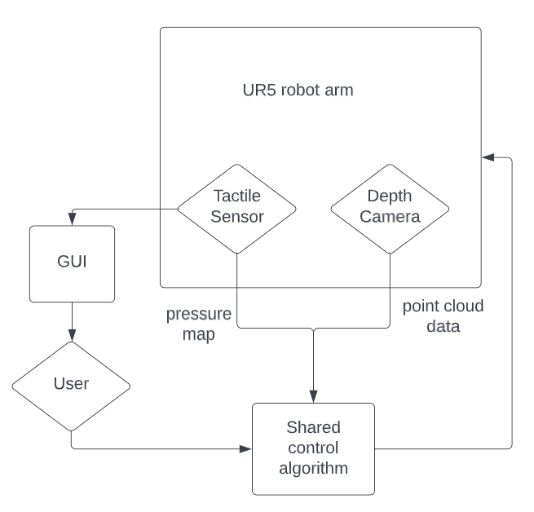

Shared control: Tactile
Target: A smooth palpation along the body with a sequence of press and release at optimum orientation
$g_{feature}$: expose the local feature
$g_{shear}$: lift and press at large shear

